Slide 1
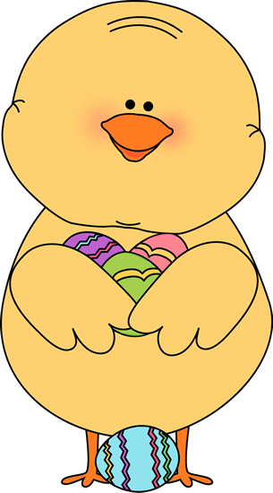
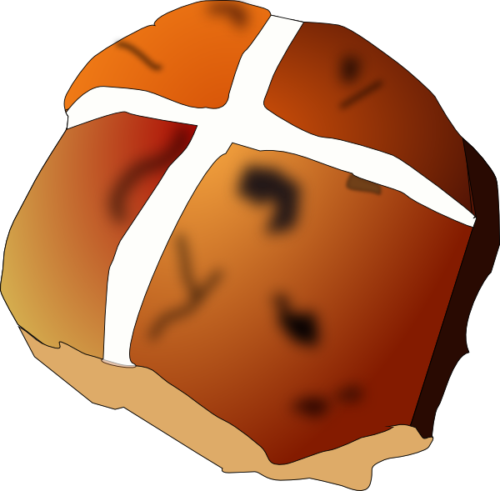
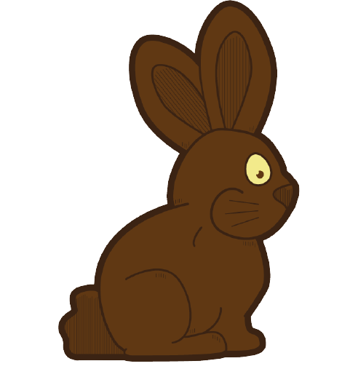
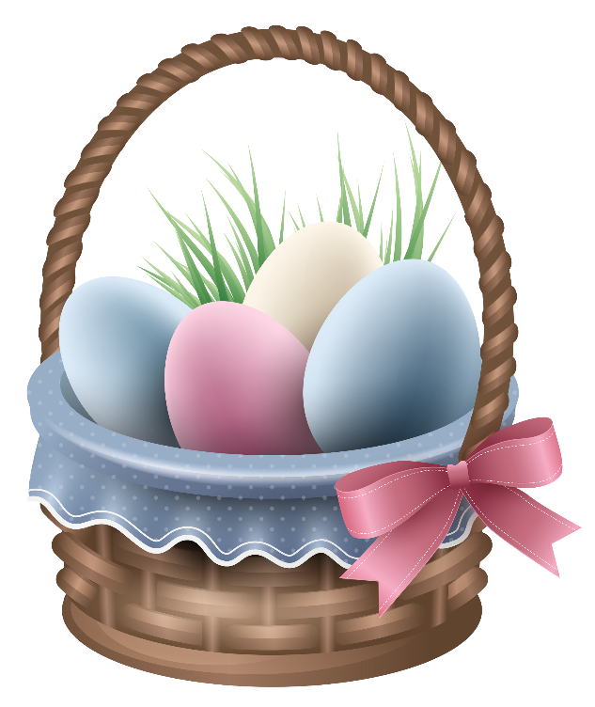
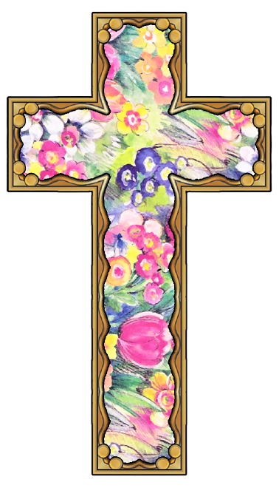
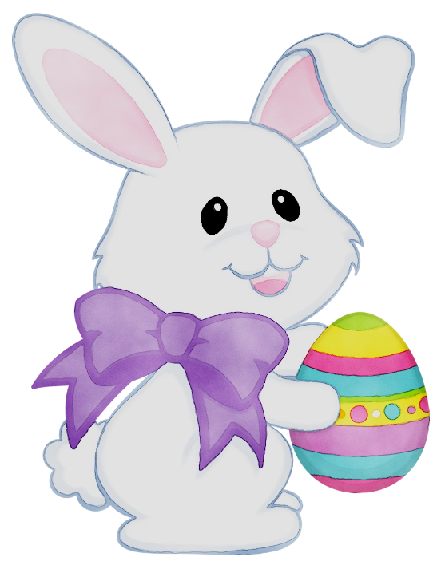
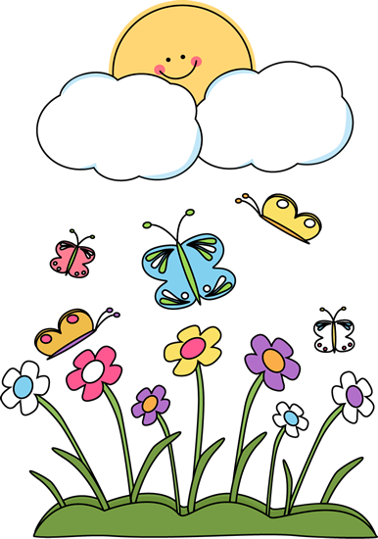
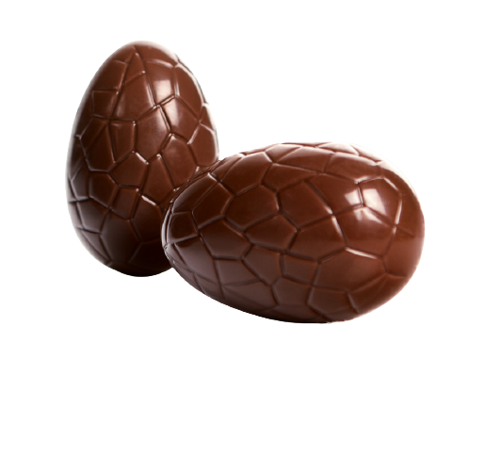
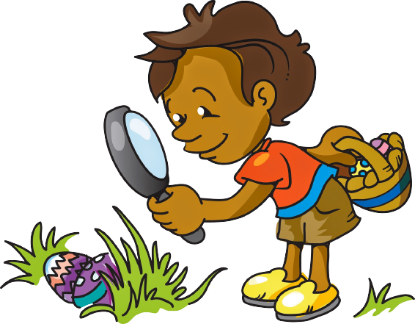
Easter
easy-distance-teaching.pl

Slide 2
HELLO MY DEAR STUDENTS

Slide 3
Let’s listen and repeat

Slide 4
Let’s sing and hop.

Slide 5
Let’s have some fun

Slide 6
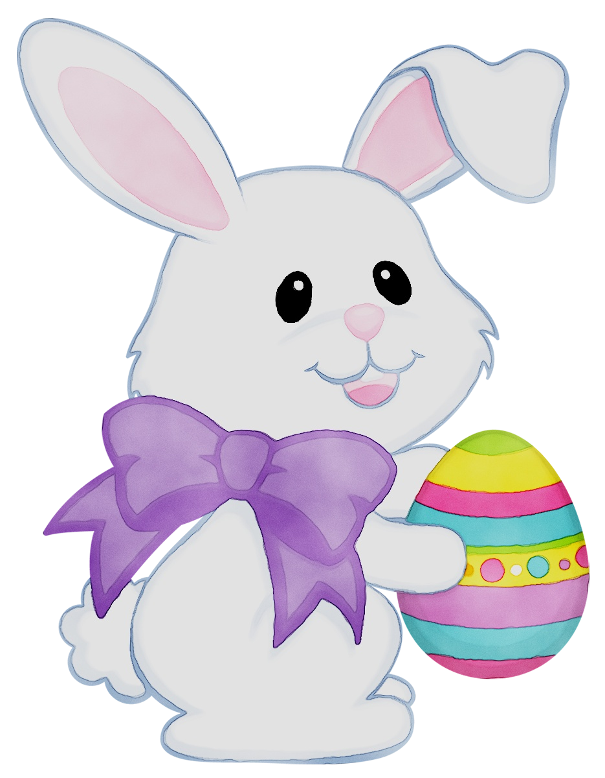

Slide 22
bunny

Slide 23
chick

Slide 24
chocolate bunny

Slide 25
chocolate eggs

Slide 26
cross

Slide 27
daffodil

Slide 28
Easter basket

Slide 29
Easter eggs

Slide 30
egg hunt

Slide 31
grass

Slide 32
hot cross bun

Slide 33
jelly beans

Slide 34
lamb

Slide 35
lily

Slide 36
spring

Slide 37
tulip

Slide 38
bunny
chick
chocolate bunny
chocolate eggs
cross
daffodil
Easter basket
Easter eggs
egg hunt
grass
hot cross bun
jelly beans
lamb
lily
spring
tulip

Slide 39
True/False
Instructions:
Ask children whether it’s true or false and click on the right word.

Slide 40
Is it true or false?
TRUE
FALSE
tulip

Slide 41
Is it true or false?
FALSE
TRUE
hot cross bun

Slide 42
Is it true or false?
TRUE
FALSE
cross

Slide 43
Is it true or false?
TRUE
bunny
FALSE

Slide 44
Is it true or false?
TRUE
FALSE
chocolate eggs

Slide 45
Is it true or false?
TRUE
egg hunt
FALSE

Slide 46
Is it true or false?
daffodil
FALSE
TRUE

Slide 47
Is it true or false?
FALSE
TRUE
grass

Slide 48
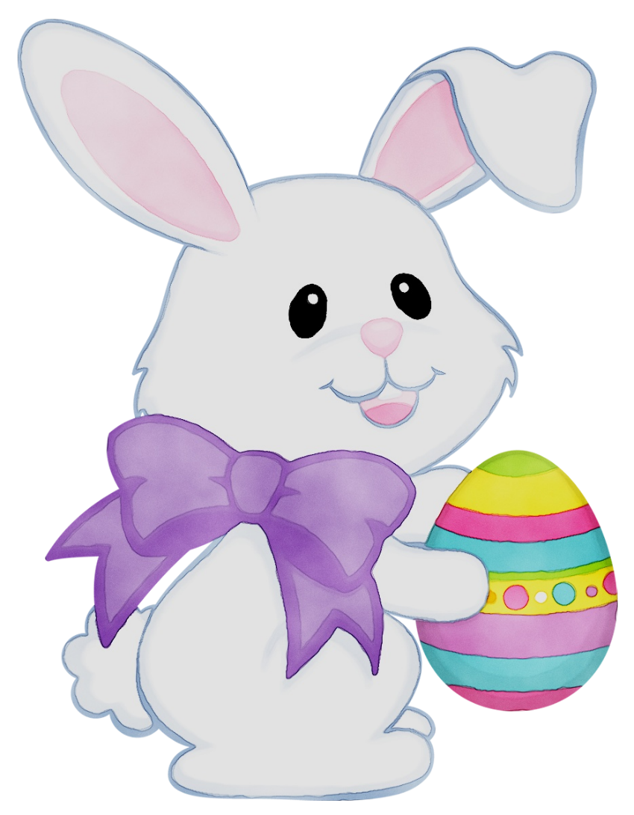
What is there in the Easter egg?
There is a bunny.
There is a …

Slide 49
What is there in the Easter egg?
There is a chick.
There is a …

Slide 50
What is there in the Easter egg?
There is a tulip.
There is a …

Slide 51
What is there in the Easter egg?
There is a cross.
There is a …

Slide 52
What is there in the Easter egg?
There is a daffodil.
There is a …

Slide 53
What is there in the Easter egg?
There is some grass.
There is some …

Slide 54
What is there in the Easter egg?
There is a …
There is a hot cross bun.

Slide 55
What is there in the Easter egg?
There is a lamb.
There is a …

Slide 56
What is there in the Easter egg?
There is a lily.
There is a …

Slide 57
What is there in the Easter egg?
There is an …
There is an Easter basket.

Slide 58
Egg hunt
Instructions:
Children answer the question. A click checks the answer.

Slide 59
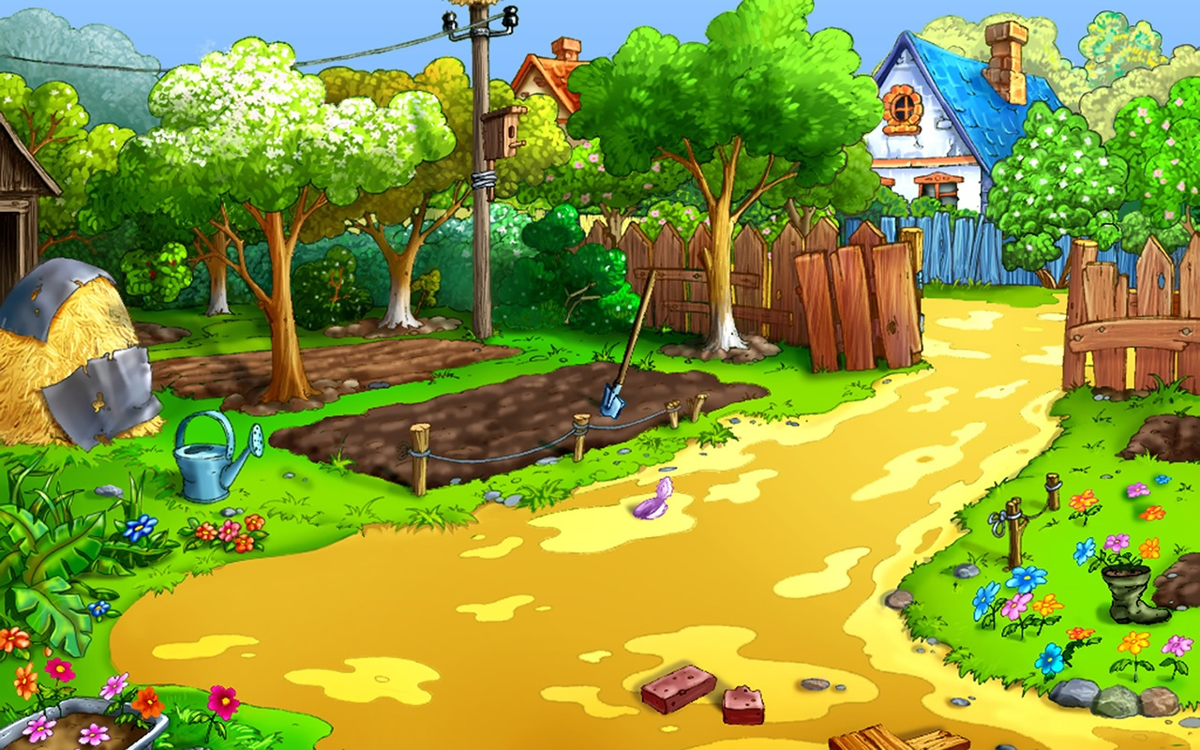
7
3
6
5
How many black eggs do you see?
4
How many blue eggs do you see?
How many yellow eggs do you see?
How many purple eggs do you see?
How many red eggs do you see?

Slide 60
What is it?
It has got four legs. It has got 2 long ears. It can jump.
It’s a bunny!

Slide 61
What is it?
It is white. It has got four legs. It is a baby animal. It has got wool.
It’s a lamb!

Slide 62
What is it?
You can smell it. It is yellow and green. It grows in spring.
It’s a daffodil!

Slide 63
What is it?
It has got four legs. It has got 2 ears. It can’t jump.
It is brown and sweet.
It’s a chocolate
bunny!

Slide 64
What is it?
It has got no ears. It can hop. It is small and yellow.
It’s a chick!

Slide 65
Ciphers
Instructions:
Children use the code to guess the words. A click reveals the answer.

Slide 66
Use the code to guess the words
C
K
H
I
C
H
I
C
K

Slide 67
Use the code to guess the words
P
U
L
T
I
T
U
L
I
P

Slide 68
Use the code to guess the words
R
P
S
I
G
N
S
P
R
I
N
G

Slide 69
Use the code to guess the words
I
F
O
L
A
D
D
A
F
F
O
D
I
L

Slide 70
Use the code to guess the words
N
T
U
G
E
H
E
G
G
H
U
N
T

Slide 71
Use the code to guess the words
A
K
S
B
E
R
T
E
A
S
T
E
R
B
A
S
K
E
T

Slide 72
Memory game
Instructions:
A child chooses 2 numbers. A click on the number opens the card. A click on the picture closes the card. If there is a pair – leave the cards open.

Slide 73
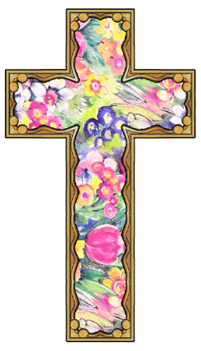
1
2
3
4
5
6
7
8
9
10
11
12

Slide 74
Board game
Instructions:
Devide the class into 2 teams marked with a red or a green circle. Roll the dice by clicking on it. Mark the team’s position by clicking its ring (red or green). It will fill up with colour. When the students land on a picture, they have to say the word in English.

Slide 75
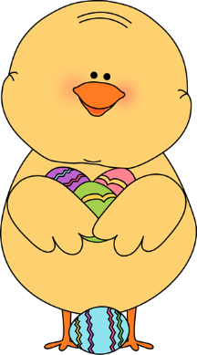
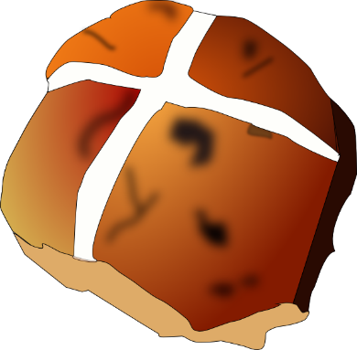
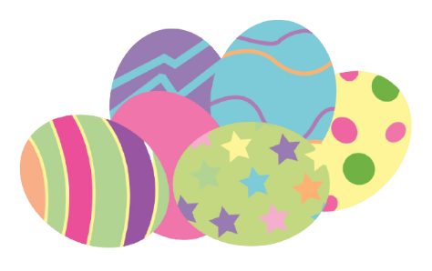
START
FINISH

